Slide 1
Full Stack Development
Palanisamy Thangamuthu

Slide 2
What is Full Stack?
Full stack development is the process of designing, creating, testing, and deploying a complete web application from start to finish.
Involves working with various technologies and tools, including front-end web development, back-end web development, and database development.
Responsible for the entire web application development process.
High demand because they can build a website or application from start to finish and quickly

Slide 3
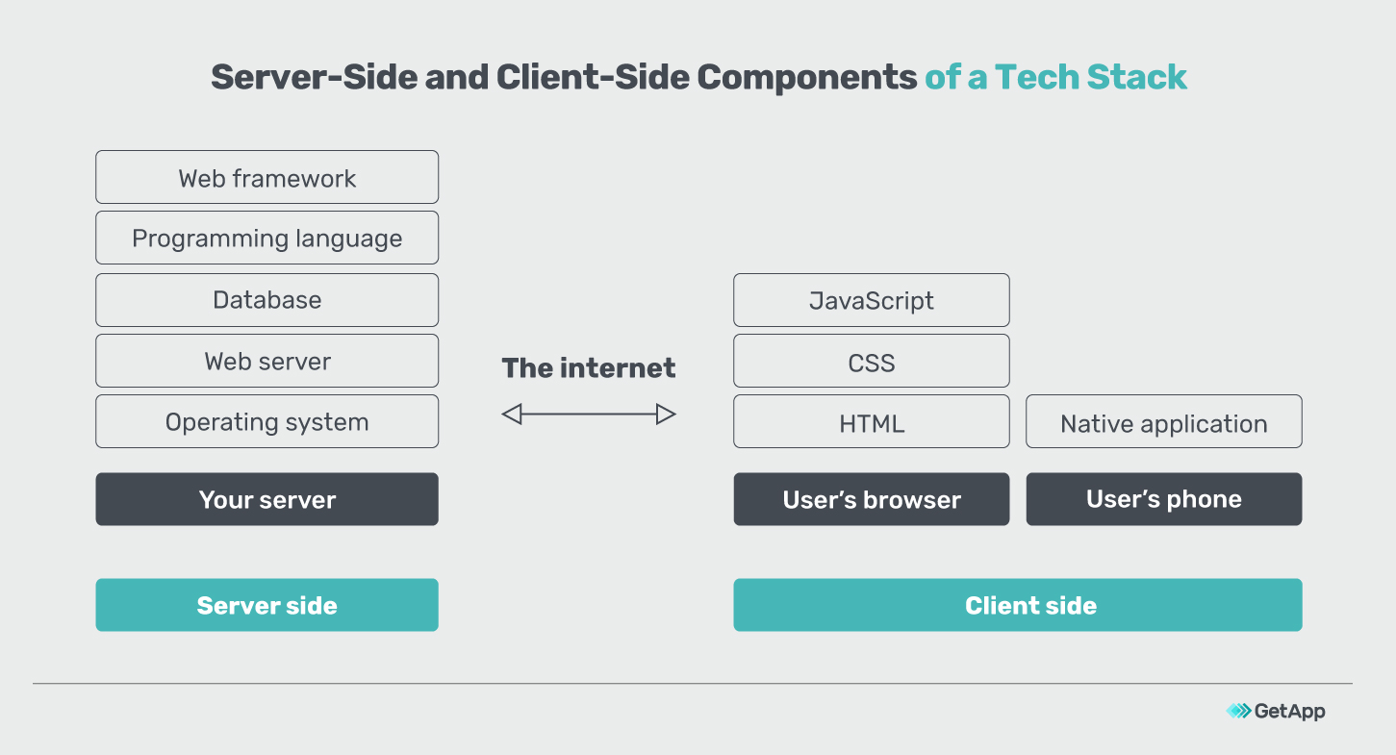
How Web Application Works?

Slide 4
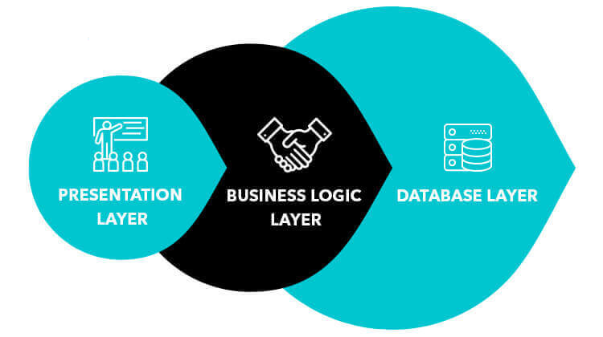
Traditional Web Development

Slide 5
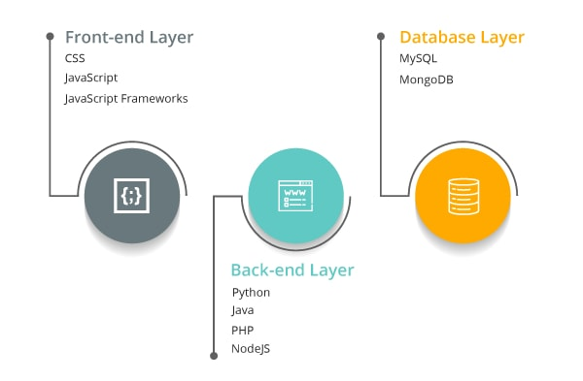
Full Stack Development

Slide 6
Frontend Technologies
HTML
CSS
Javascript Libraries such as jQuery, React, ZeptoJS
Frameworks like Angular, Vue, Backbone, Ember
Bootstrap

Slide 7
Backend Technologies
Java(Spring)
PHP(Laravel)
NodeJs(Express)
Python(Django, Flask, Pylons)
Ruby(Ruby on Rails)

Slide 8
Databases
Mysql
PostgreSQL
MongoDB
CouchDB
Oracle

Slide 9
Servers
Apache
Nginx

Slide 10
Popular Stacks
MEAN Stack: MongoDB, Express, AngularJS and Node.js.
MERN Stack: MongoDB, Express, ReactJS and Node.js
Django Stack: Django, python and MySQL as Database.
Rails or Ruby on Rails: Uses Ruby, PHP and MySQL.
LAMP Stack: Linux, Apache, MySQL and PHP.

Slide 11
Frontend Technologies
HTML, CSS, Bootstrap & React

Slide 12
HTML
HTML - What is HTML?
<html>
<head>
</head>
<body>
<div>
<p>Hi</p>
</div>
</body>
</html>
HTML means Hyper Text Markup Language.
The HTML allow us to define structure of a document.
NOT programming language, it’s a markup language.
It is a series of nested tags (it is a subset of XML) that contain all the website information like texts, images and videos.
<title>This is a title</title>
The HTML defines the page structure. A website can have several HTMLs to different pages.

Slide 13
HTML - Syntax
<div id="main">
<!-- this is a comment -->
This is text without a tag.
<button class="mini">press me</button>
<img src="me.png" />
</div>

Slide 14
HTML Attributes
Elements/Tags
Attributes
Values
Comments
Text Tag
Self-closing Tag

Slide 15
HTML Tags
Headings - <h1> to <h6>
Paragraphs - <p>
Links - <a>
Images - <img>
Buttons - <button>
Lists, Tables, Audio, Video,....

Slide 16
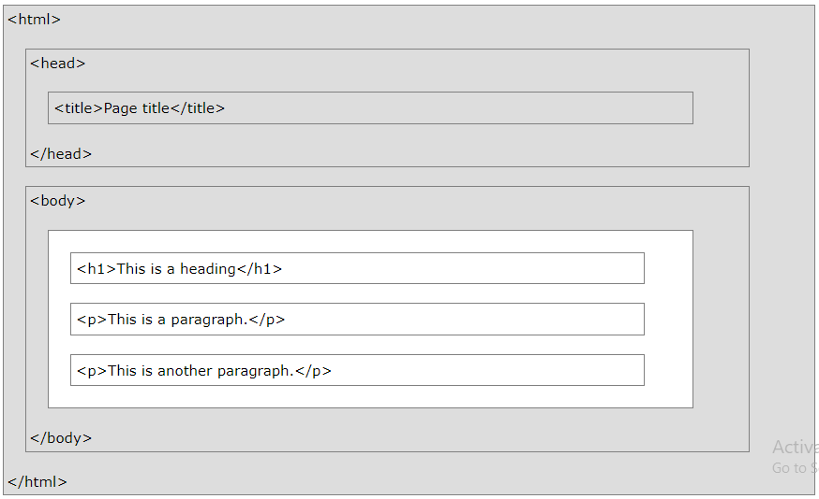
DOM Structure

Slide 17
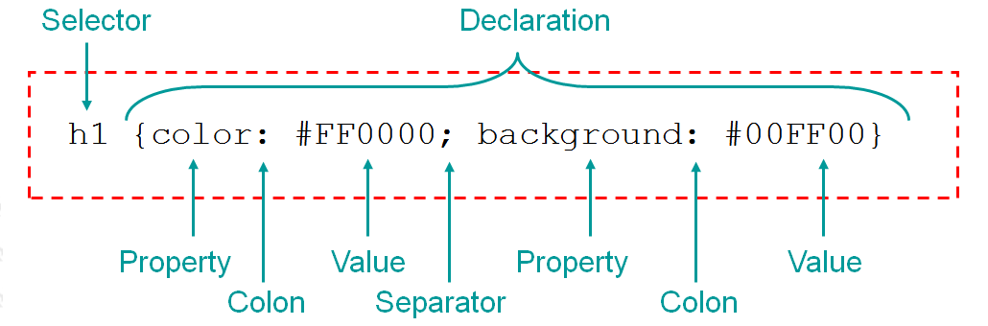
HTML
CSS - What is CSS?
CSS stands for Cascading Style Sheets
CSS describes how HTML elements are to be displayed

Slide 18
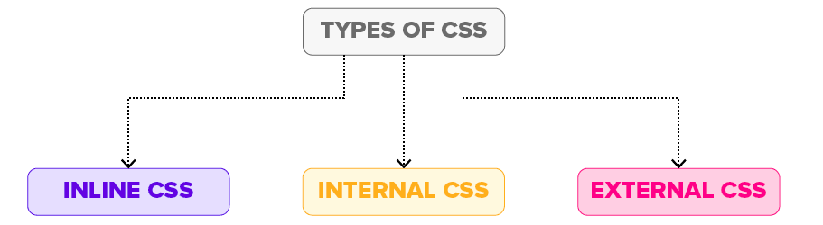
HTML
CSS - Types of Stylesheets

Slide 19
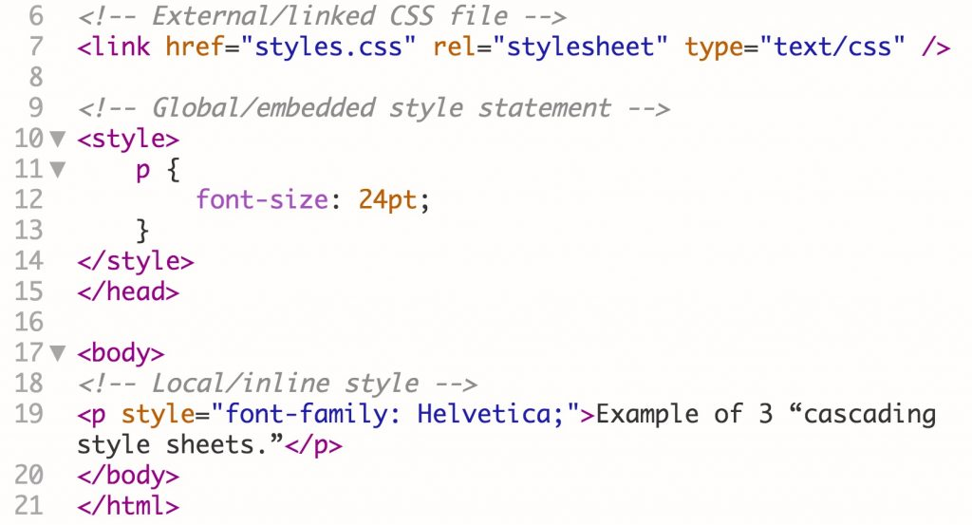
HTML
CSS - Types of Stylesheets

Slide 20
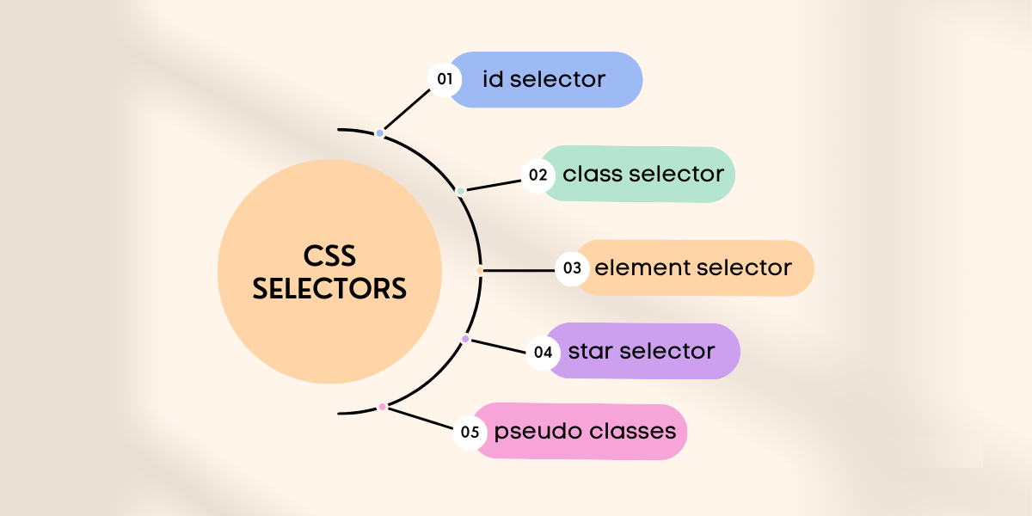
CSS Selectors

Slide 21
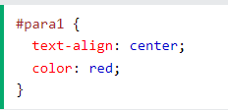
Id selector
The id selector uses the id attribute of an HTML element to select a specific element.
The id of an element is unique within a page, so the id selector is used to select one unique element!
To select an element with a specific id, write a hash (#) character, followed by the id of the element.

Slide 22
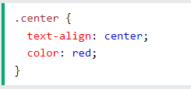
Class selector
The class selector selects HTML elements with a specific class attribute.
To select elements with a specific class, write a period (.) character, followed by the class name.

Slide 23

Element selector
The element selector selects all elements with the specified element name.

Slide 24
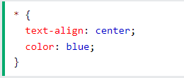
The CSS Universal Selector(Start Selector)
The universal selector (*) selects all HTML elements on the page.

Slide 25
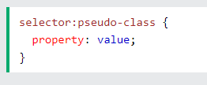
CSS Pseudo-classes
A pseudo-class is used to define a special state of an element.
For example, it can be used to:
Style an element when a user mouses over it
Style visited and unvisited links differently
Style an element when it gets focus

Slide 26
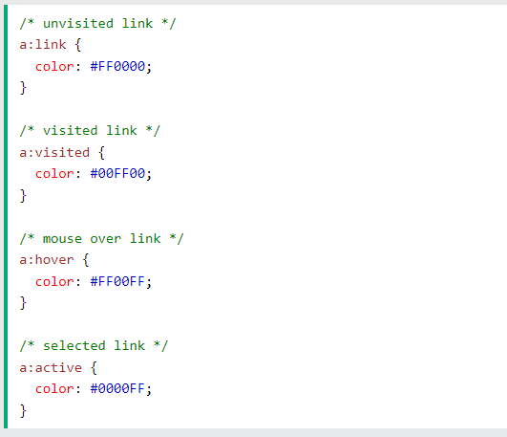
CSS Pseudo-classes - Example

Slide 27
Twitter Bootstrap - What is Bootstrap?
Bootstrap is a open source front-end framework(HTML & CSS)
It is a collection of CSS classes and JS functions get ready to use.
Bootstrap includes HTML and CSS based design templates for typography, forms, buttons, tables, navigation,....
Bootstrap also gives you the ability to easily create responsive designs.

Slide 28
Twitter Bootstrap - Advantages
Easy to Use
Responsive Features
Mobile-first Approach
Browser Compatibility

Slide 29
Getting Started with Bootstrap
https://getbootstrap.com/docs/5.2/getting-started/introduction/

Slide 30
What is React.js?
React is a javascript library for building user interfaces
It is a Library not a framework like Angular, Backbone, etc..
Developed by Facebook
Opensource.

Slide 31
Why was React developed?
Complexity of two-way data binding
Bad UX from using “cascading updates” of DOM tree
A lot of data on a page changing over time
Complexity of Facebook’s UI architecture
Shift from MVC mentality

Slide 32
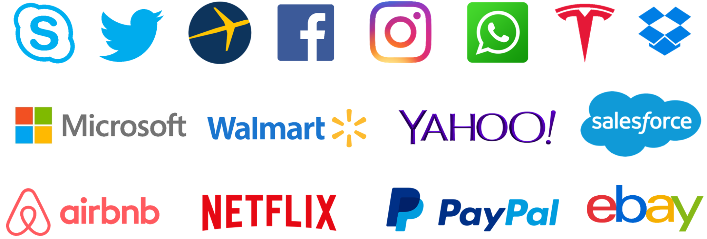
Who uses React?

Slide 33
React.JS History
Facebook Software Engineer, Jordan Walke, created it.
React.JS was first used in 2011 for Facebook's Newsfeed feature.
Initial Release to the Public (V0.3.0) was in July 2013.
Current version of React.JS is V18.0.0 (April 2022).

Slide 34
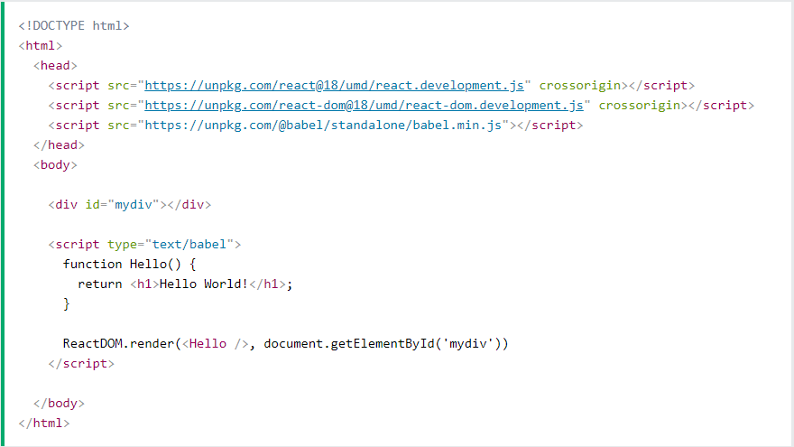
React Getting Started

Slide 35
React Getting Started…
3 Libraries included react, react-dom, babel.
First two let us write React code in our JavaScripts.
Babel, allows us to write JSX syntax and ES6 in older browsers.
To use React in production, you need npm which is included with Node.js.

Slide 36
Setting up a React Environment
Creating a React application requires you to set up build tools such as Babel and Webpack.
These build tools are required because React's JSX syntax is a language that the browser doesn't understand.
Create React App (CRA) is a tool to create single-page React applications that is officially supported by the React team.

Slide 37
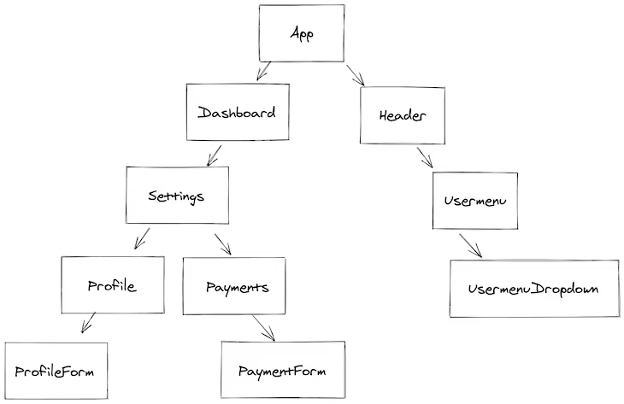
React Fundamentals - Application Structure

Slide 38
React Fundamentals - Component
Components are self-contained reusable building blocks of web application.
React components are basically just idempotent functions (same input produces same output).
They describe your UI at any point in time, just like a server-rendered app.

Slide 39
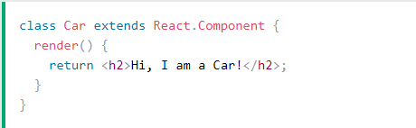
Class Component
When creating a React component, the component's name MUST start with an uppercase letter.

Slide 40
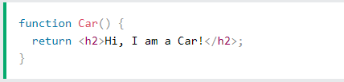
Functional Component
A Function component also returns HTML, and behaves much the same way as a Class component, but Function components can be written using much less code, are easier to understand, and will be preferred in this tutorial.

Slide 41
React Fundamentals - Props
props stands for properties.
Props are arguments passed into React components.
Props are passed to components via HTML attributes.
accessed via this.props or props (in functional component).

Slide 42
React Fundamentals - State
Represents internal state of the component
Accessed via this.state
When a component's state data changes, the rendered markup will be updated by re-invoking render() method
The state can be updated by the props cannot.

Slide 43
React Events
Just like HTML DOM events, React can perform actions based on user events.
React has the same events as HTML: click, change, mouseover etc.
React events are written in camelCase syntax.
React event handlers are written inside curly braces.

Slide 44
React Router
Create React App doesn't include page routing.
React Router is the most popular solution.
To add it, run:
npm install --save react-router-dom

Slide 45
CRUD Operations
Create
Read
Update
Delete

Slide 46
Database
MongoDB

Slide 47
What is a database
A database is a structured, organized set of data.
Common examples of databases:
Telephone book
Student records
Database management systems are computer software applications that interact with user, other apps, and the db itself to capture and analyze data.
Well-known DBMSs include MYSQL, PostgreSQL, Oracle and IBM DB2

Slide 48
MongoDB - What is MongoDB
Scalable High-Performance Open-Source, Document-oriented database.
Built for Speed.
Rich document based queries for Easy readability.
Full index support for High Performance.
Replication and Failover for High Availability.
Map/Reduce for Aggregation.

Slide 49
Why to use MongoDB?
SQL was invented in the 70’s to store data.
MongoDB stores documents or objects.
Nowadays everyone works with objects(Python/Node/Java…)
We need db to store objects, why not store them directly?
Embedded docs & arrays reduce needs for joins.

Slide 50
What is MongoDB great for?
RDBMS replacement for web applications.
Semi-structured content management systems.
Real-time analytics and High-speed logging.
Caching and High scalability.
Web 2.0, Media, SAAS, Gaming, Healthcare, Telecom, Government,....

Slide 51
Not great for?
Highly transactional applications.
MongoDB requires more storage than other well-known databases.
It doesn't automatically clean up its disk space, so it must be done manually.
It isn't easy to join two documents in MongoDB.
Their document is restricted in size to 16 MB.
Document nesting at a depth of more than 100 layers is not allowed.

Slide 52
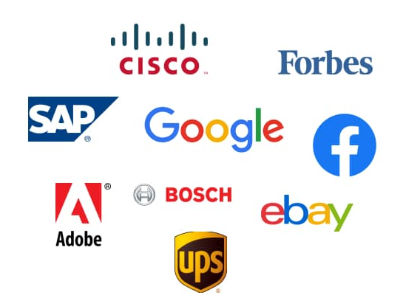
Who is using MongoDB?

Slide 53
Database = Database
Made up of multiple collections.
Created on-the-fly when referenced for the first time.

Slide 54
Collection = Table
Schema-less, and contains documents.
Indexable by one or more keys.
Created on-the-fly when referenced for the first time.
Capped Collections: Fixed size, older records get dropped after reaching the limit.

Slide 55
Document = Record
Stored in a collection.
Can have _id key - works like primary keys in mySQL
Supported relationships.
Document storage in BSON(Binary form of JSON) format.

Slide 56
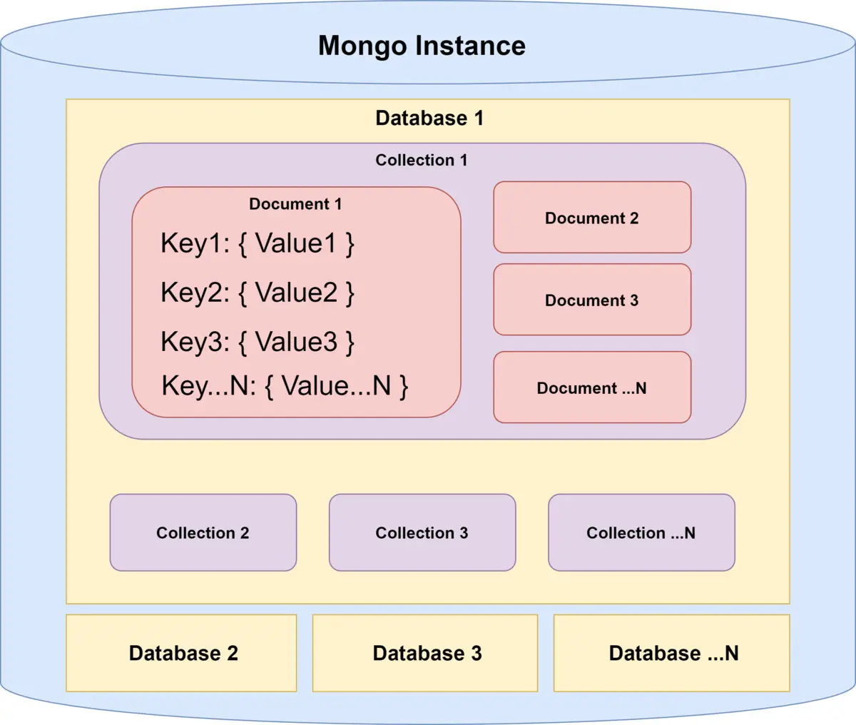
Database - How it look likes?

Slide 57
Backend
NodeJs & Express

Slide 58
What is NodeJS?
In simple words it is “Server side Javascript”.
V8 is open-source Javascript engine developed by Google. Its written using C++ and used in chrome browser.
Node.js runs on V8.
Its open-source runs on Linux, Windows and other OS as well.
High performance network applications framework, well optimized for concurrent environments.

Slide 59
What is NodeJS?
It’s a command line tool.
Its written in 40% Js and 60% C++.
It uses an event-driven, non-blocking I/O model, which makes it lightweight.
It makes use of event-loops via Javascript’s callback functionality to implement non blocking I/O.
Programs in node.js are written in Javascript but not the same. There will be no DOM implementation provided in Node.js
Everything in node.js runs in a single-thread.

Slide 60
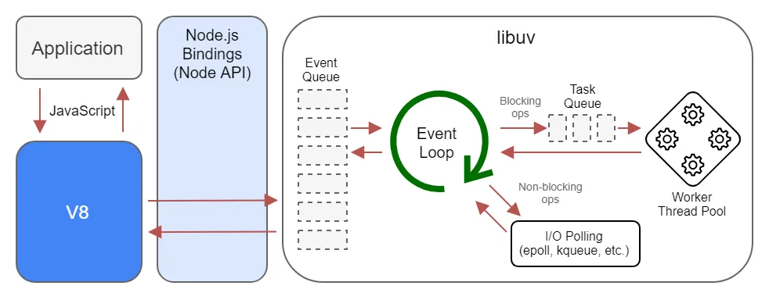
NodeJS - Event Loops

Slide 61
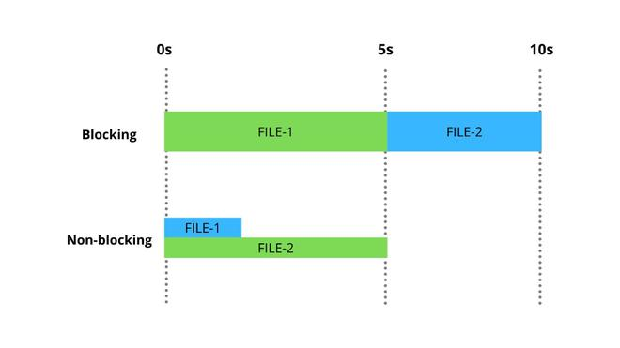
NodeJS - Non-blocking

Slide 62
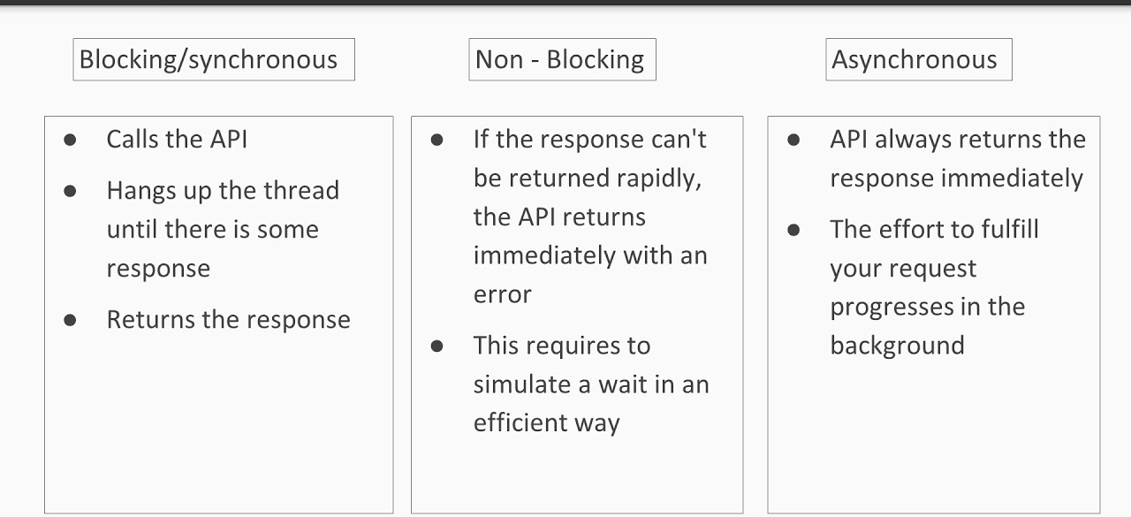
Blocking & Non-blocking Difference

Slide 63
What can you do with NodeJS
You can create HTTP Server
Can create TCP Server in just 4 lines of code
You can create DNS Server
You can create Static File Server
You can create Web Chat Application in browser
Can also be used to create online games, collaboration tools or sends updates to the user in real-time.

Slide 64
NodeJS Ecosystem
NodeJS heavily relies on modules
Creating a module is very easy, just put your js code in a separate file and include it in your code using import.
Libraries in NodeJs are called as packages and they can be installed using “npm install packagename”
NPM(Node Package Manager) comes bundled with node.js installation.

Slide 65
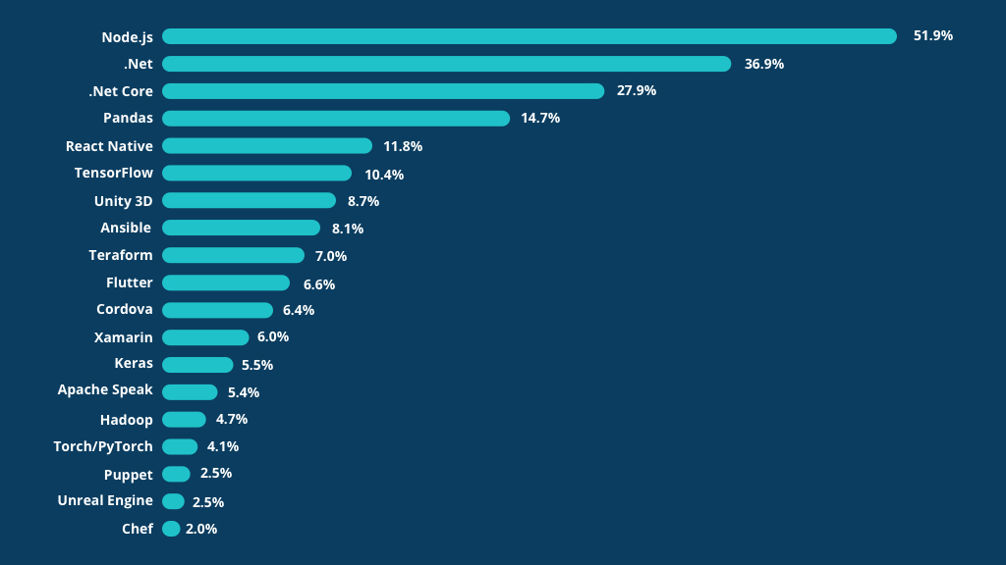
NodeJS Benchmarks

Slide 66
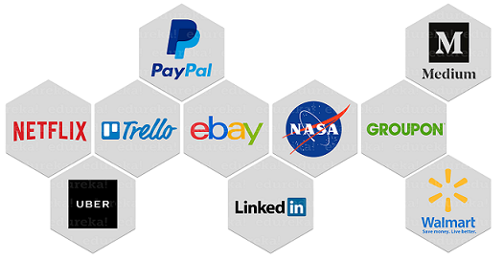
Who is using NodeJS

Slide 67
Disadvantages of NodeJS
When doing heavy and CPU intensive calc - event-loops are CPU hungry
NPM Dependency Nightmare
It has tons of nested callbacks
It has an unstable API
It has high demand but few experienced developers

Slide 68
What is Express Js?
Minimalist web application framework
Runs on NodeJS.
It is used to build a single page, multipage, and hybrid web application.
It's a layer built on the top of the Node js that helps manage servers and routes.

Slide 69
Express - REST API Overview
Method | URLs | Action
GET | /users | Get all users
GET | /users/:id | Get the user by id
POST | /users | Add a new user
PUT | /users/:id | Update the user by id
PATCH | /users/:id | Update the user properties by id
DELETE | /users/:id | Remove the user by id

Slide 70
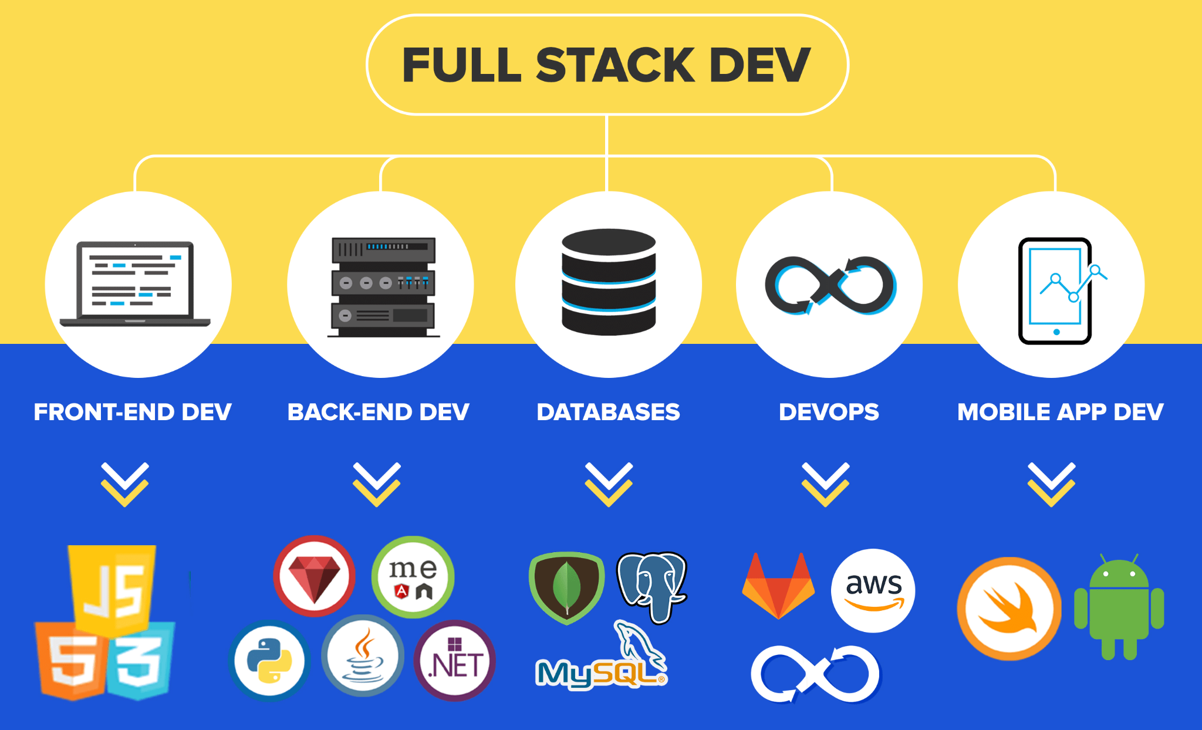
FSE - Roadmap

Slide 71
Thank You!!
9952175204
mailtopalanii@gmail.com
https://www.linkedin.com/in/tpalanii/

